Slide 1
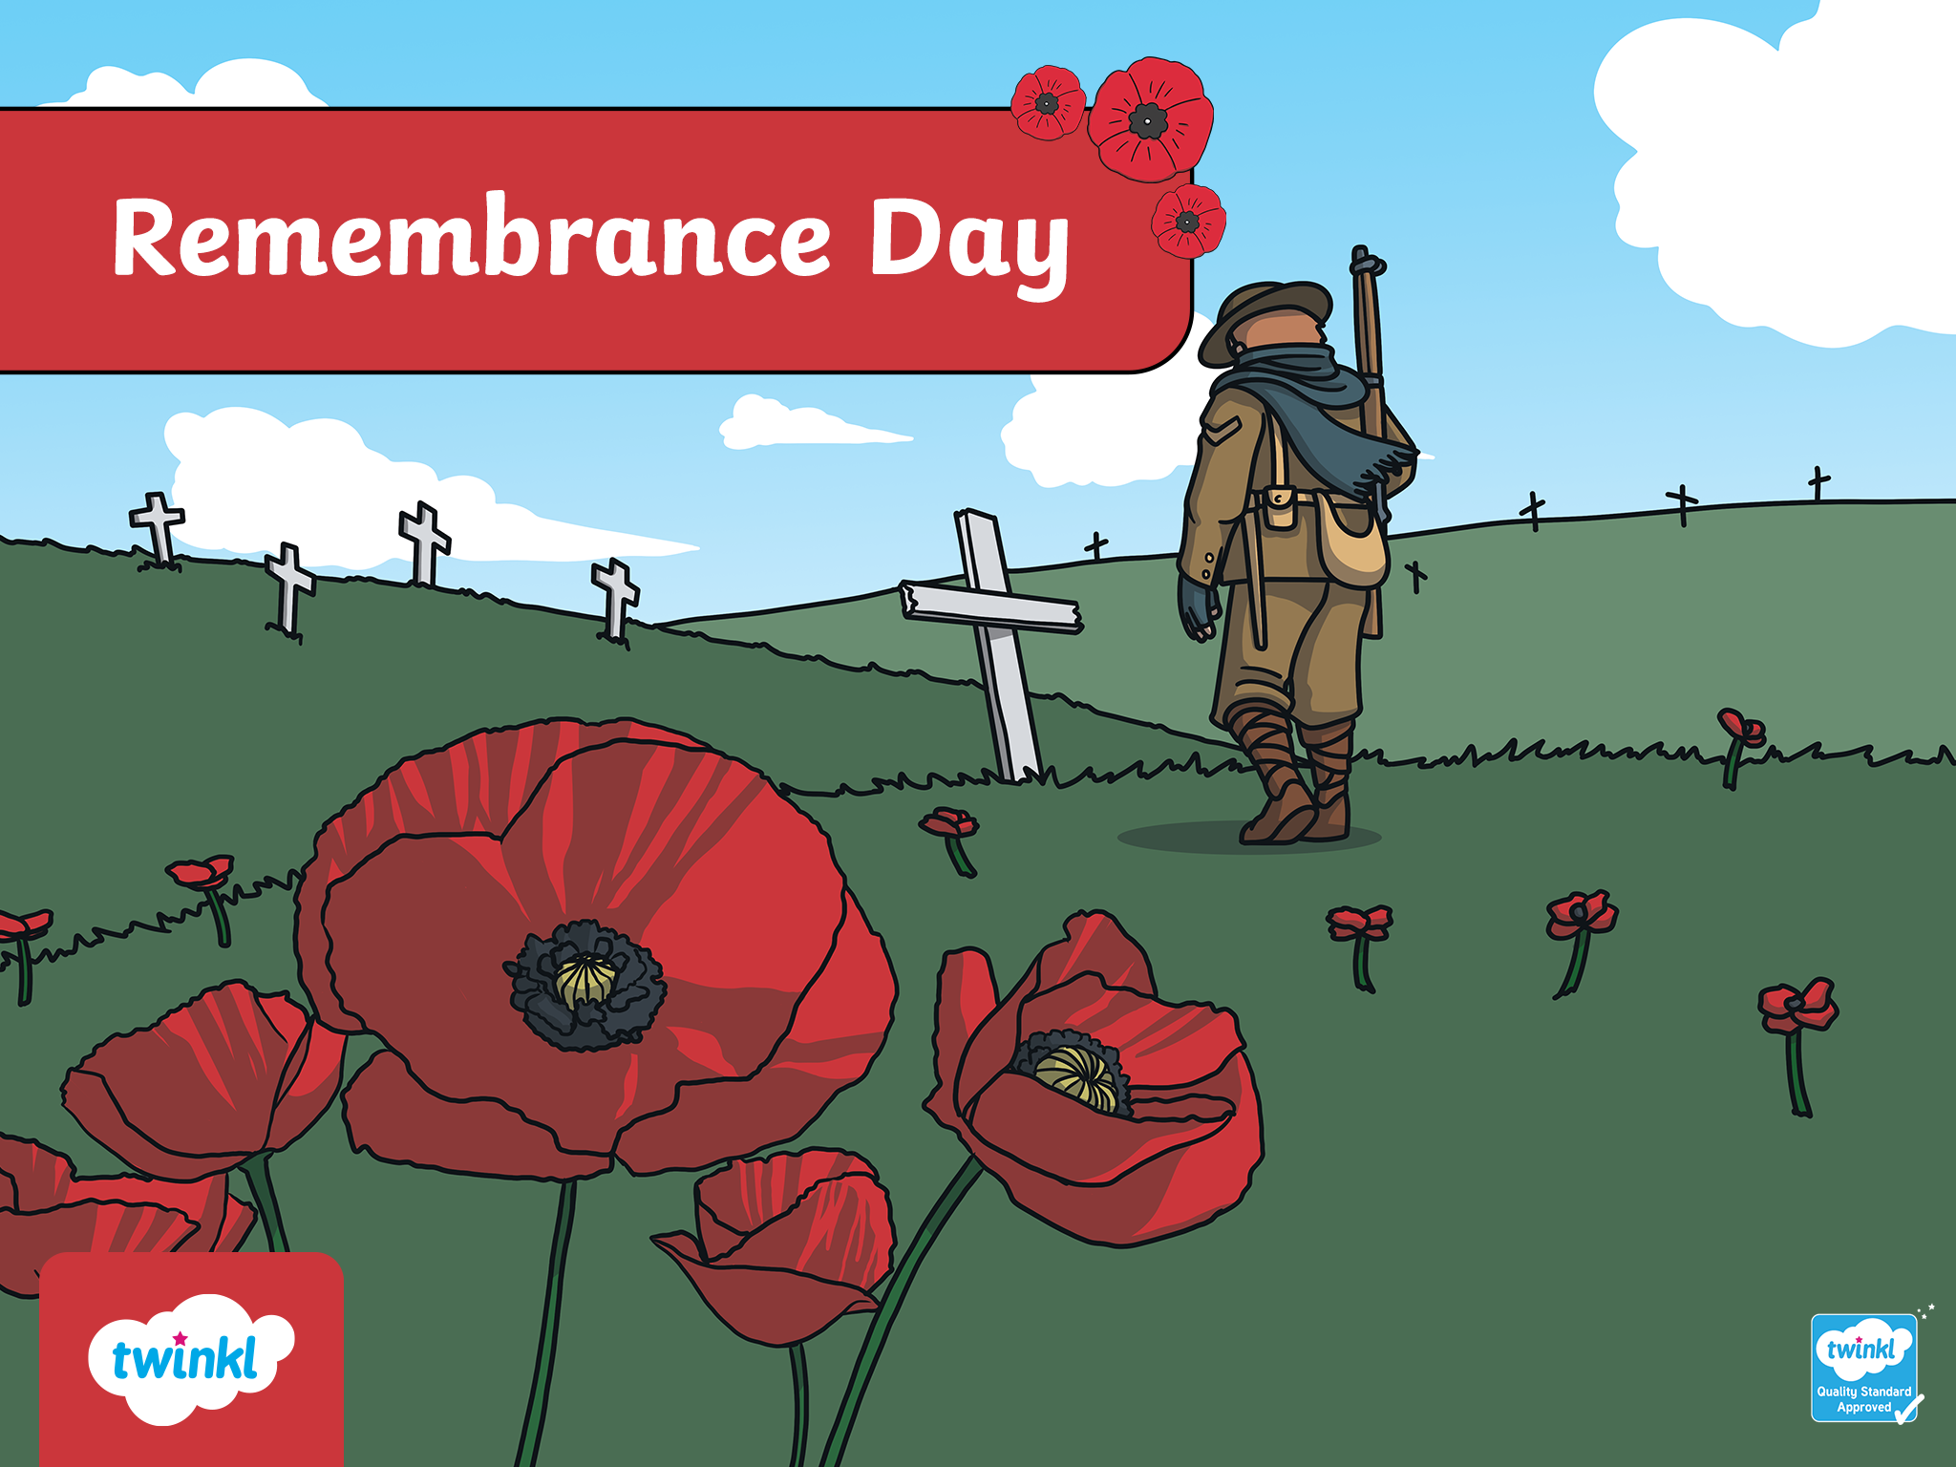

Slide 2
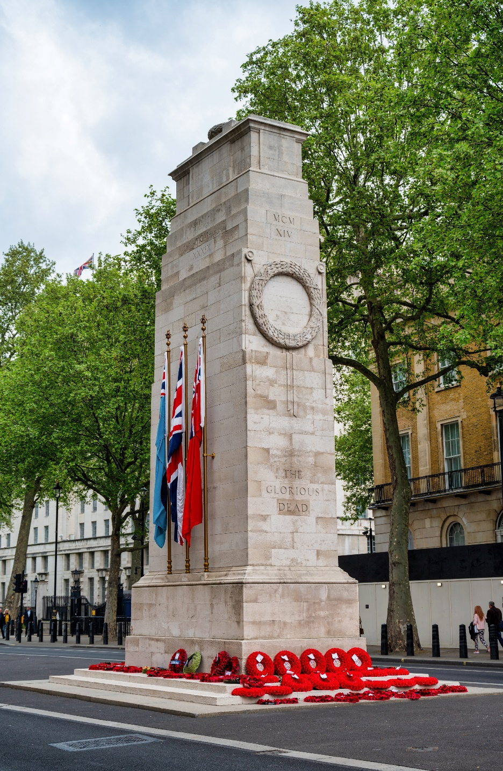
Cenotaph
shawnwil23_Shutterstock.com

Slide 3
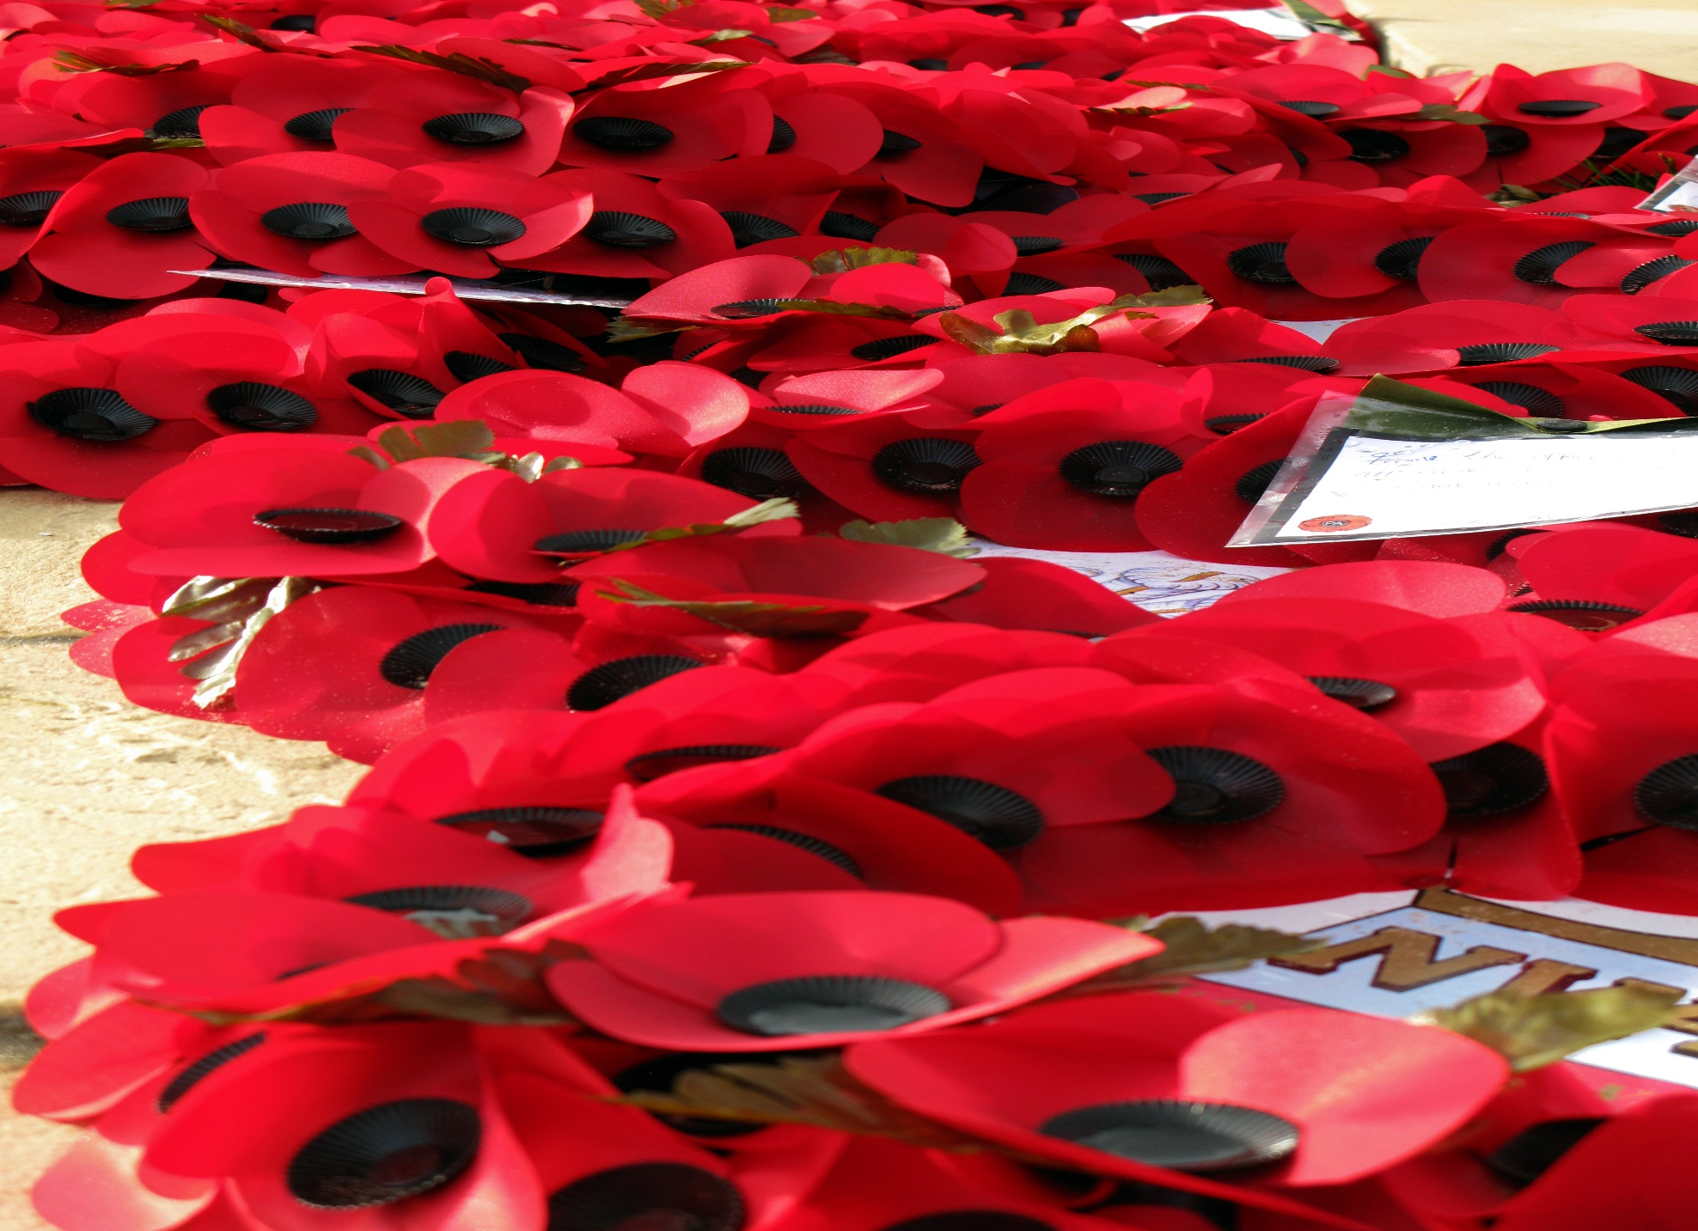
poppies

Slide 4
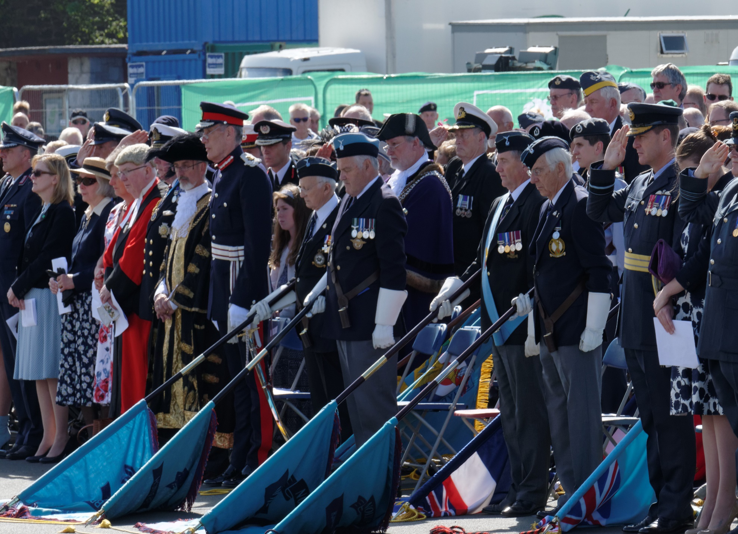
two-minute silence
Roger_Mechan - Shutterstock.com

Slide 5
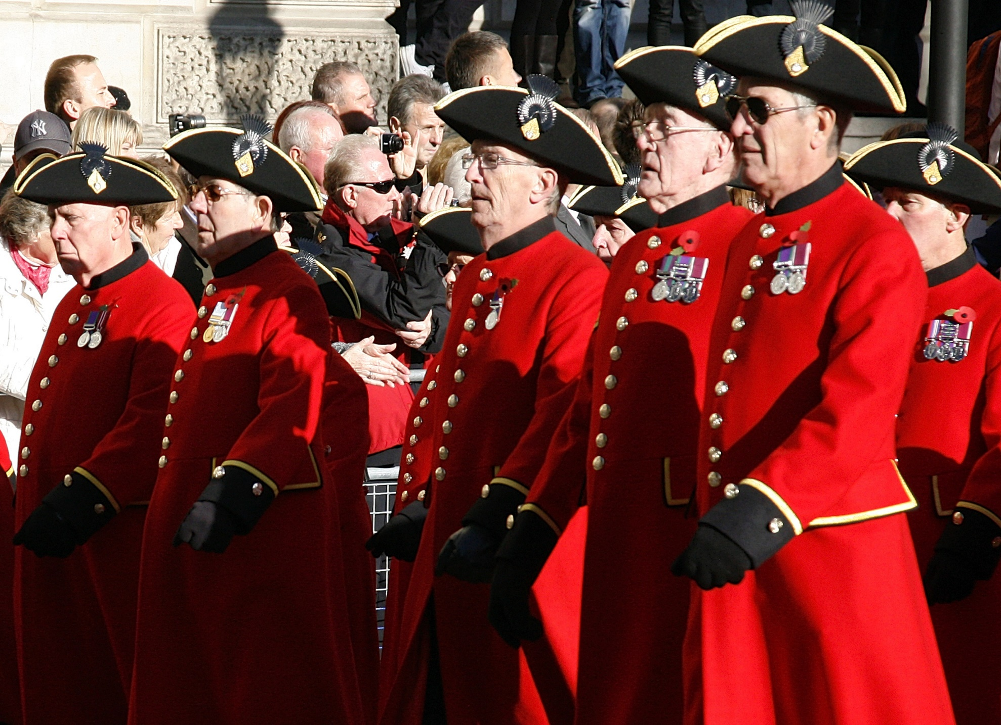
veterans
Roger_Mechan - Shutterstock.com

Slide 6
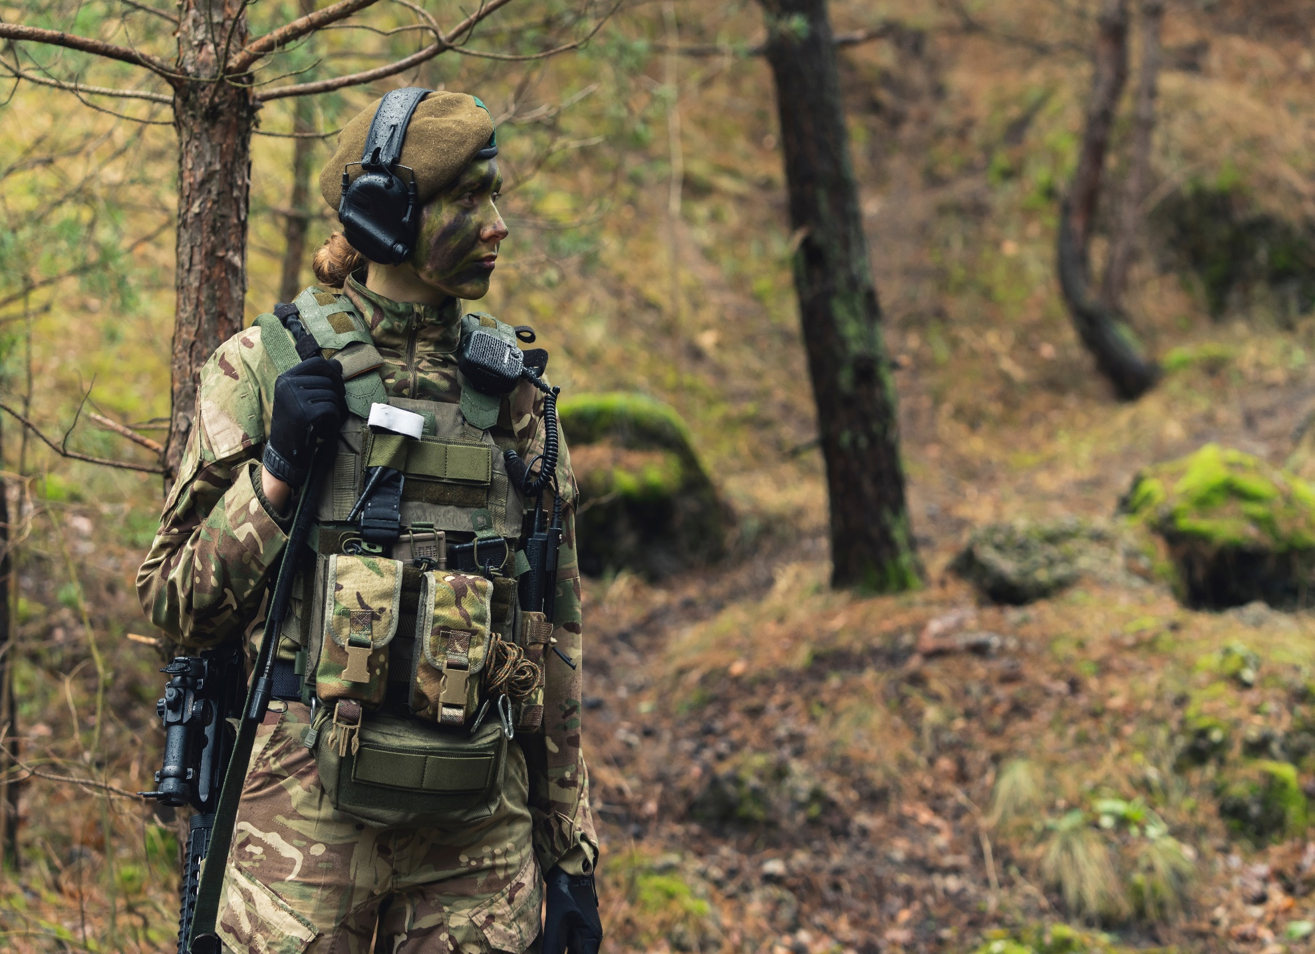
soldier

Slide 7
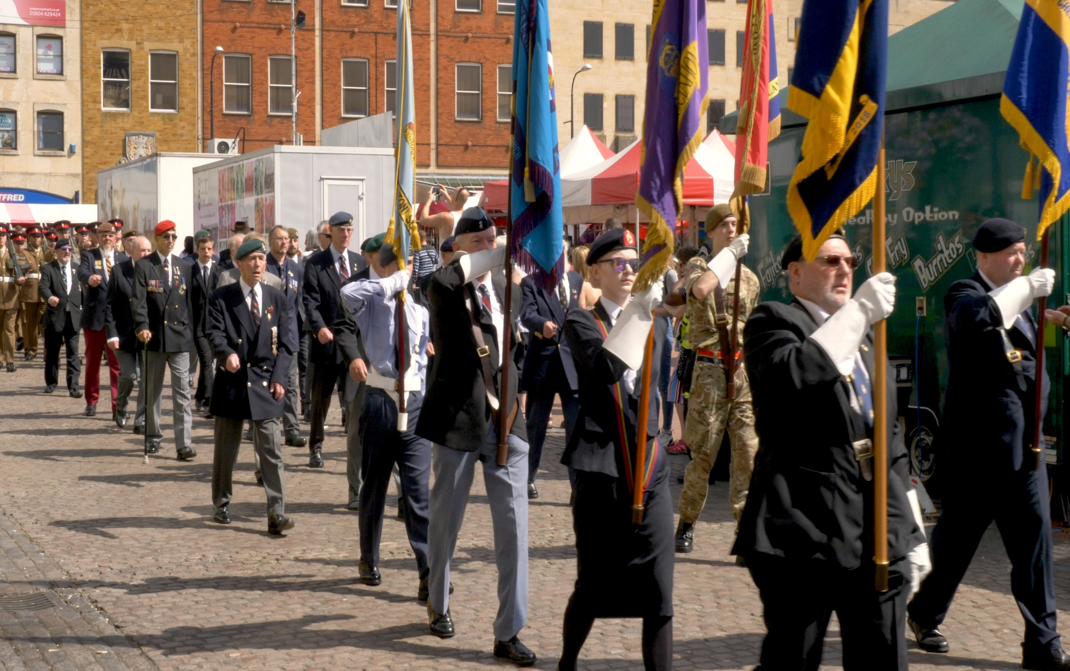
parade
Jevanto Productions- Shutterstock.com

Slide 8
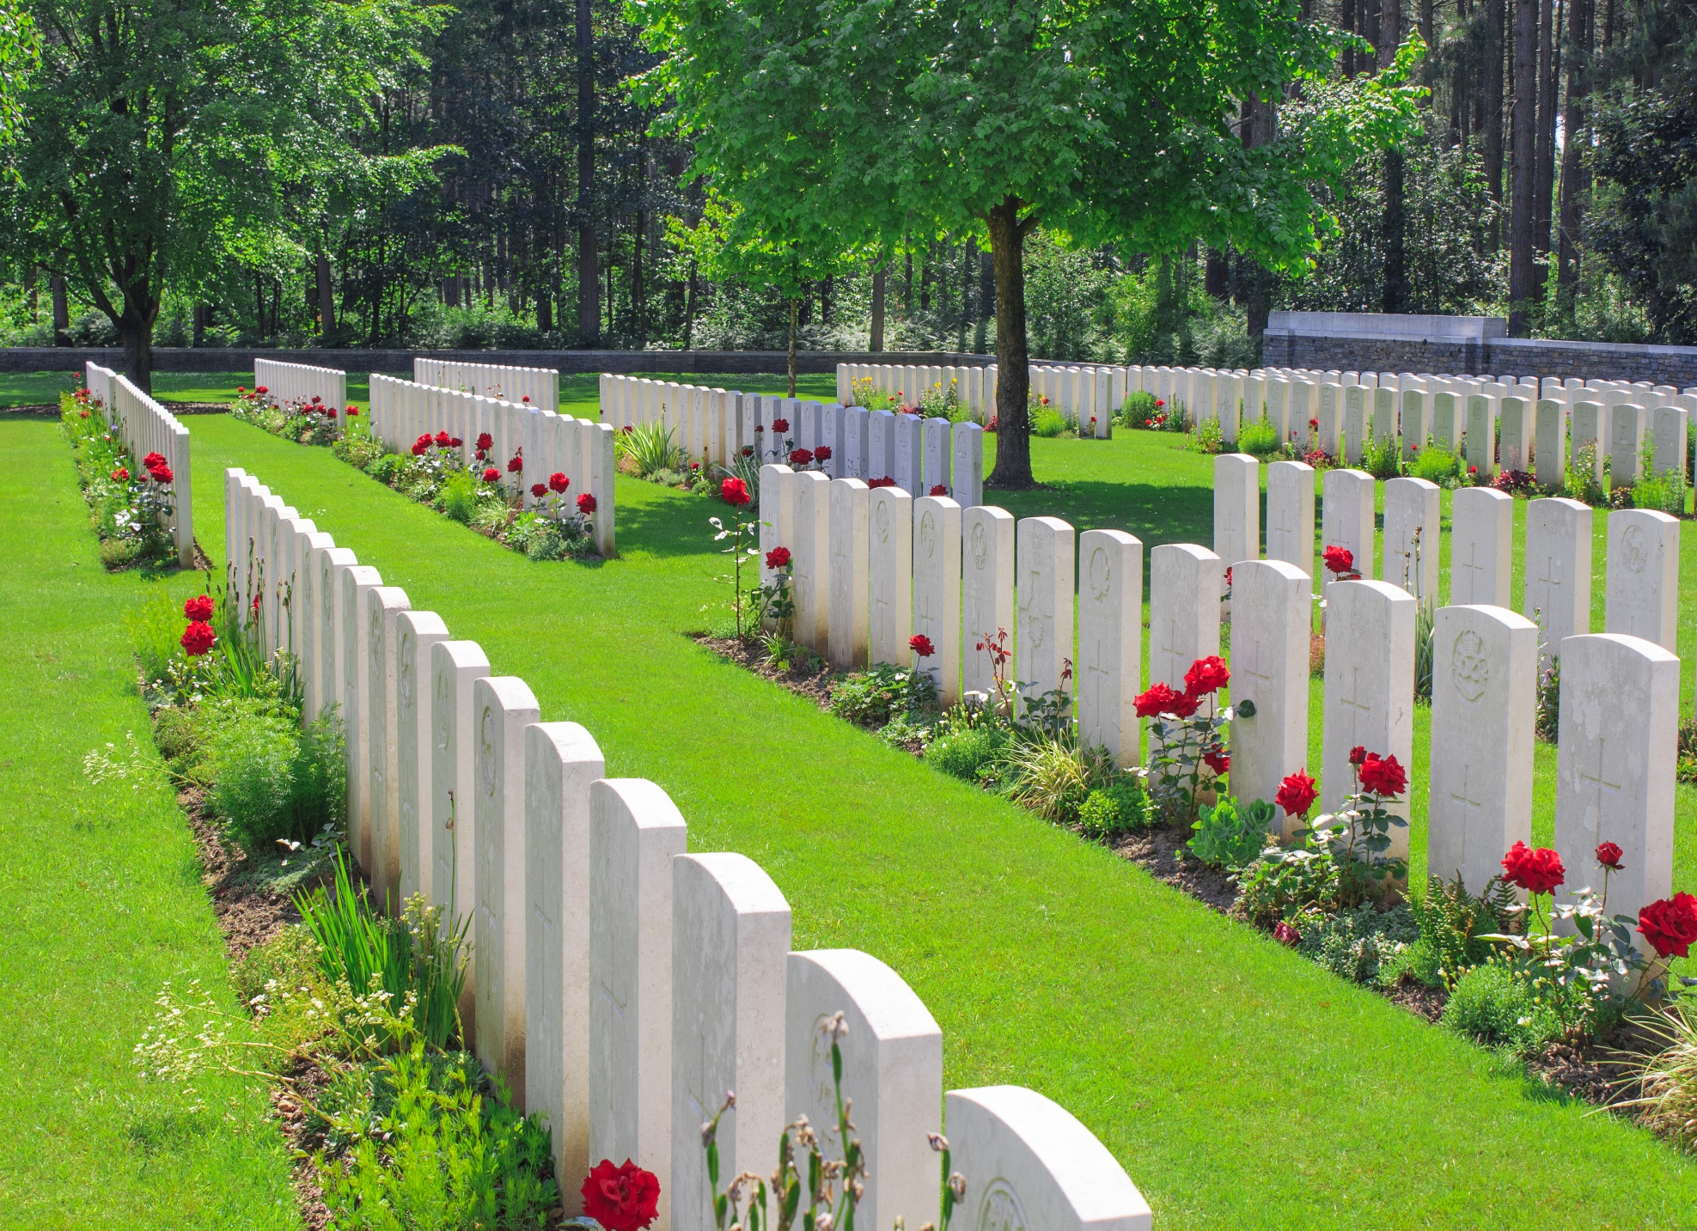
war graves

Slide 9
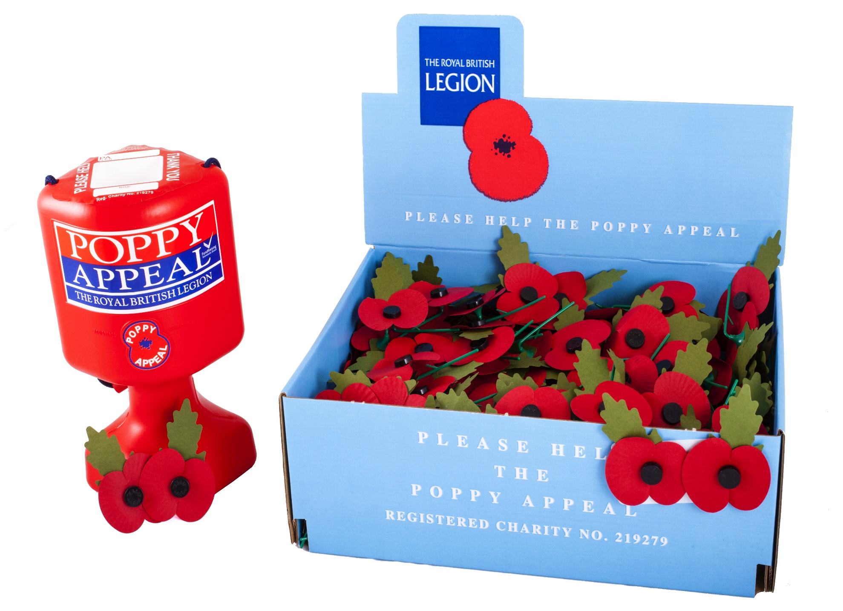
poppy appeal
chrisdorney/Shutterstock.com

Slide 10
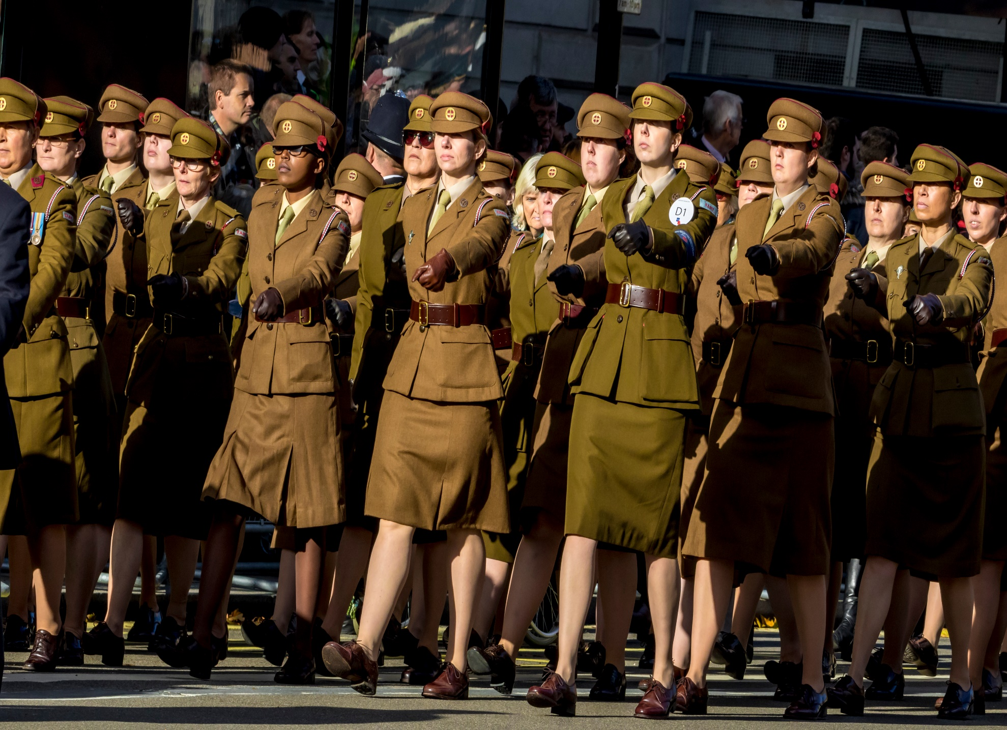
march
Alan Fraser Images - Shutterstock.com

Slide 11
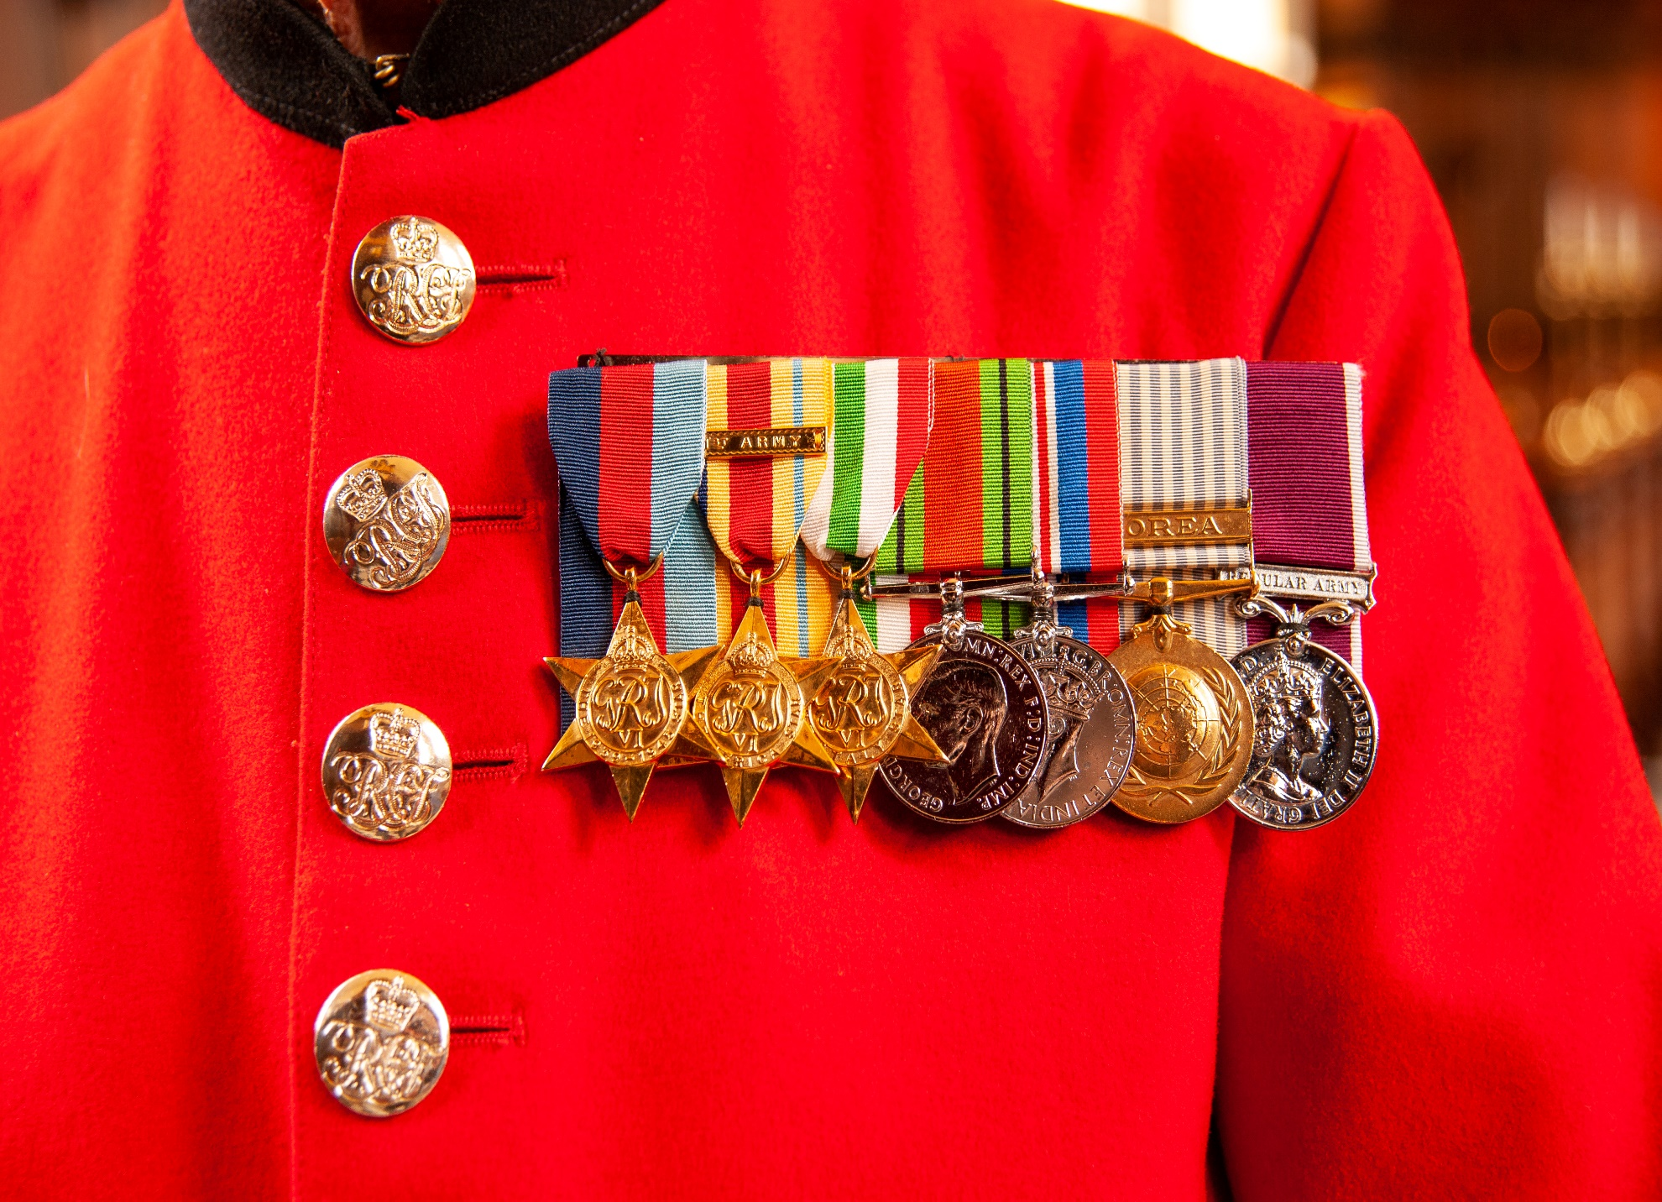
medals
Alex Segre - Shutterstock.com

Slide 12
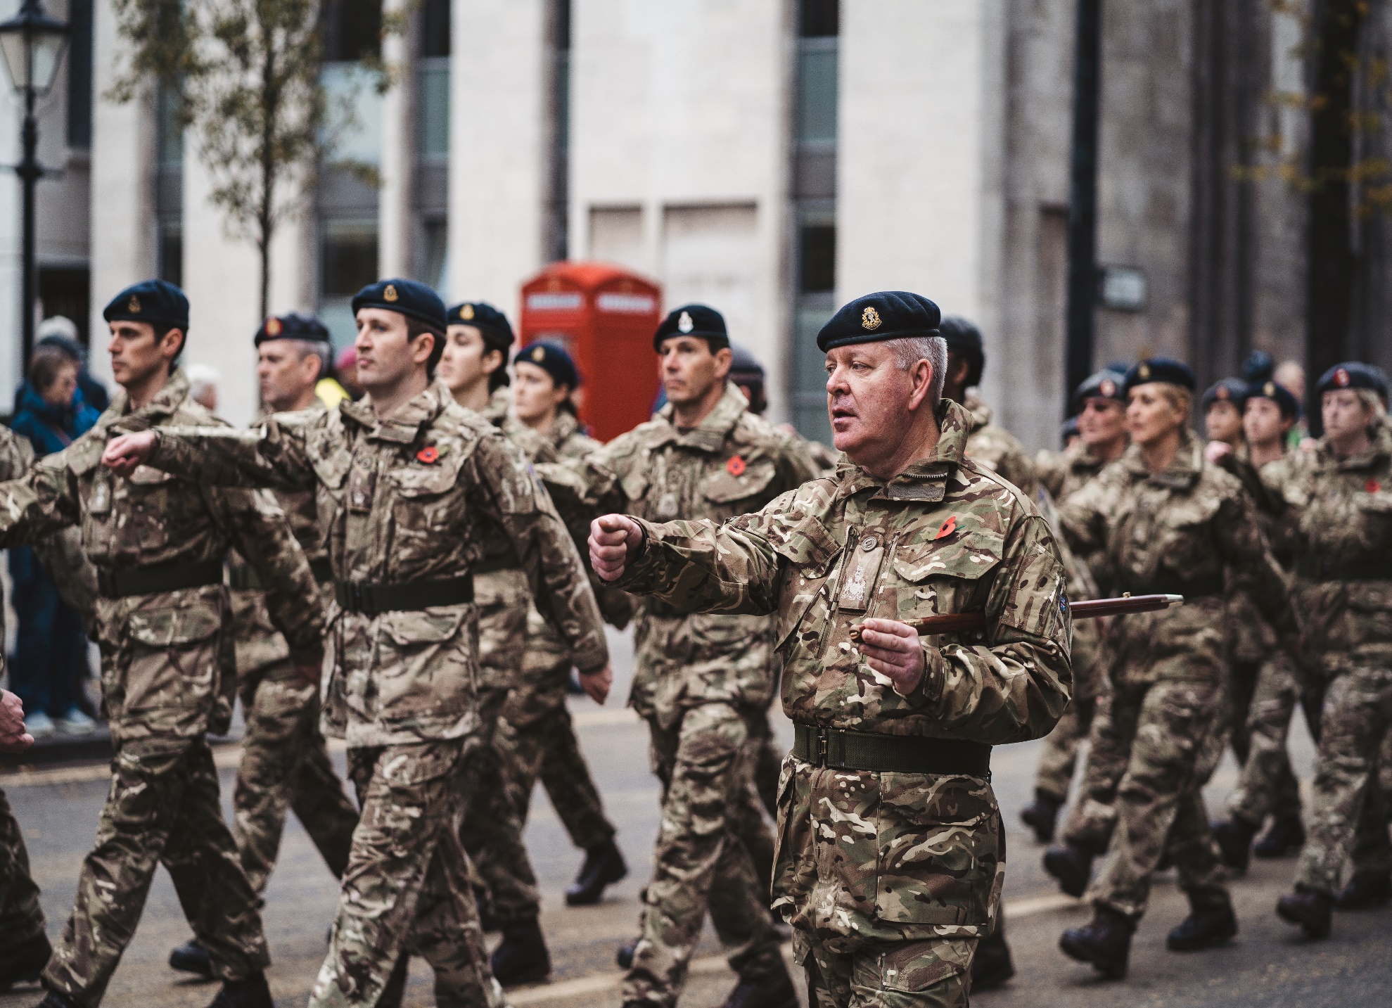
modern veterans
Sandor Szmutko - Shutterstock.com

Slide 13
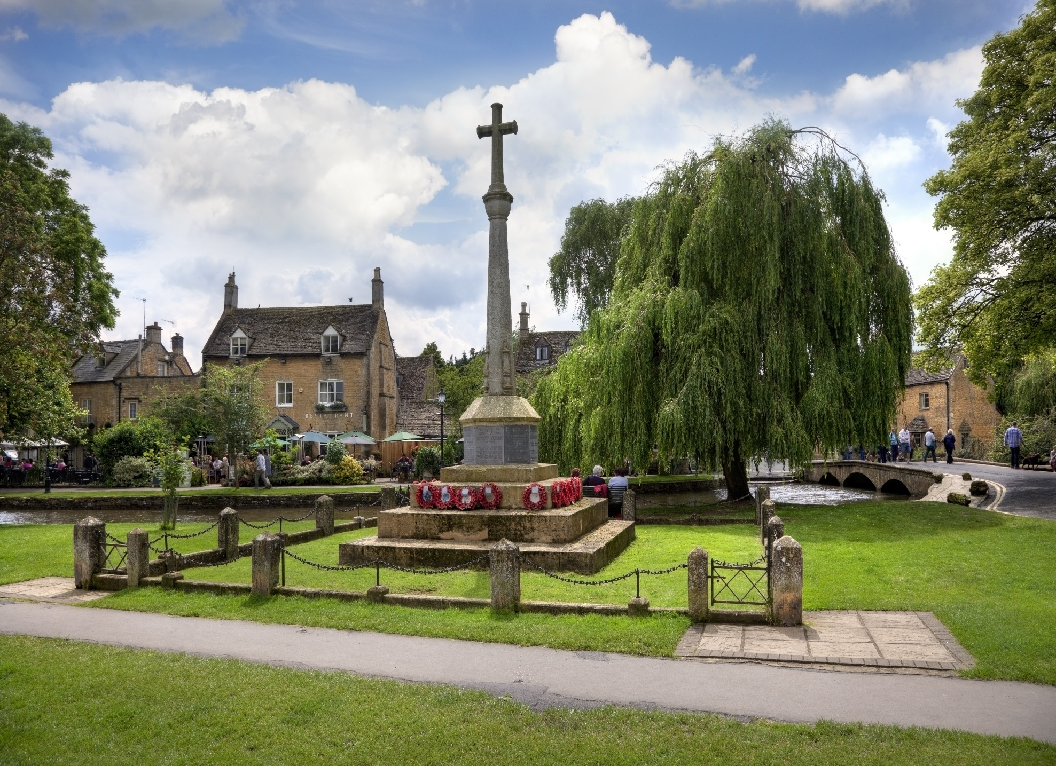
war memorial

Slide 14
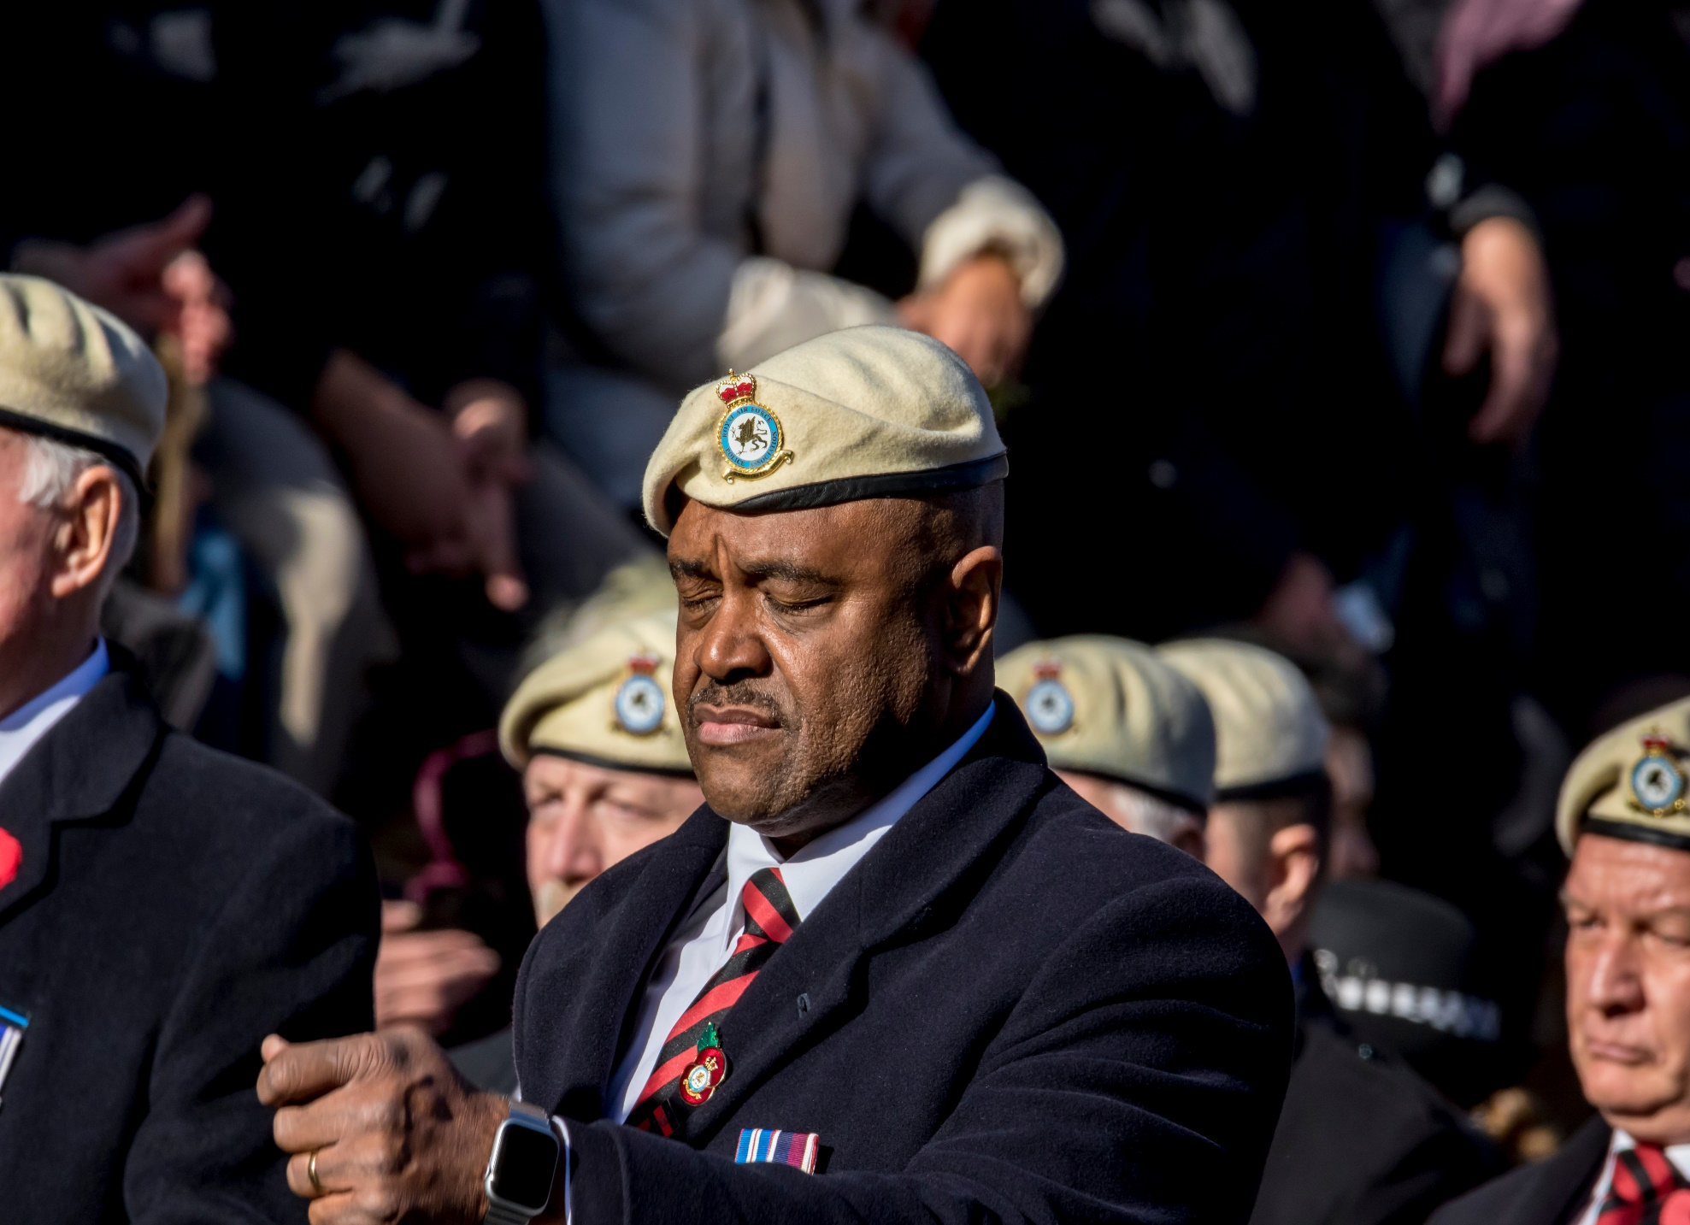
veteran
Alan Fraser Images - Shutterstock.com

Slide 15
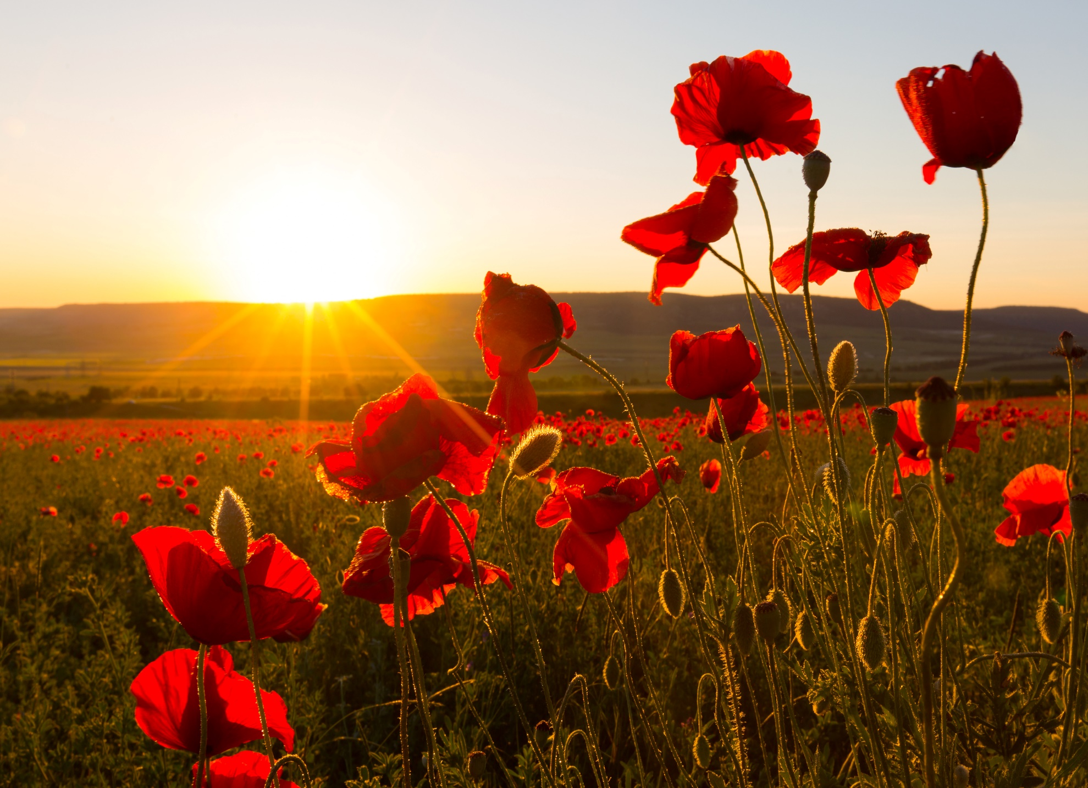
field of poppies

Slide 16
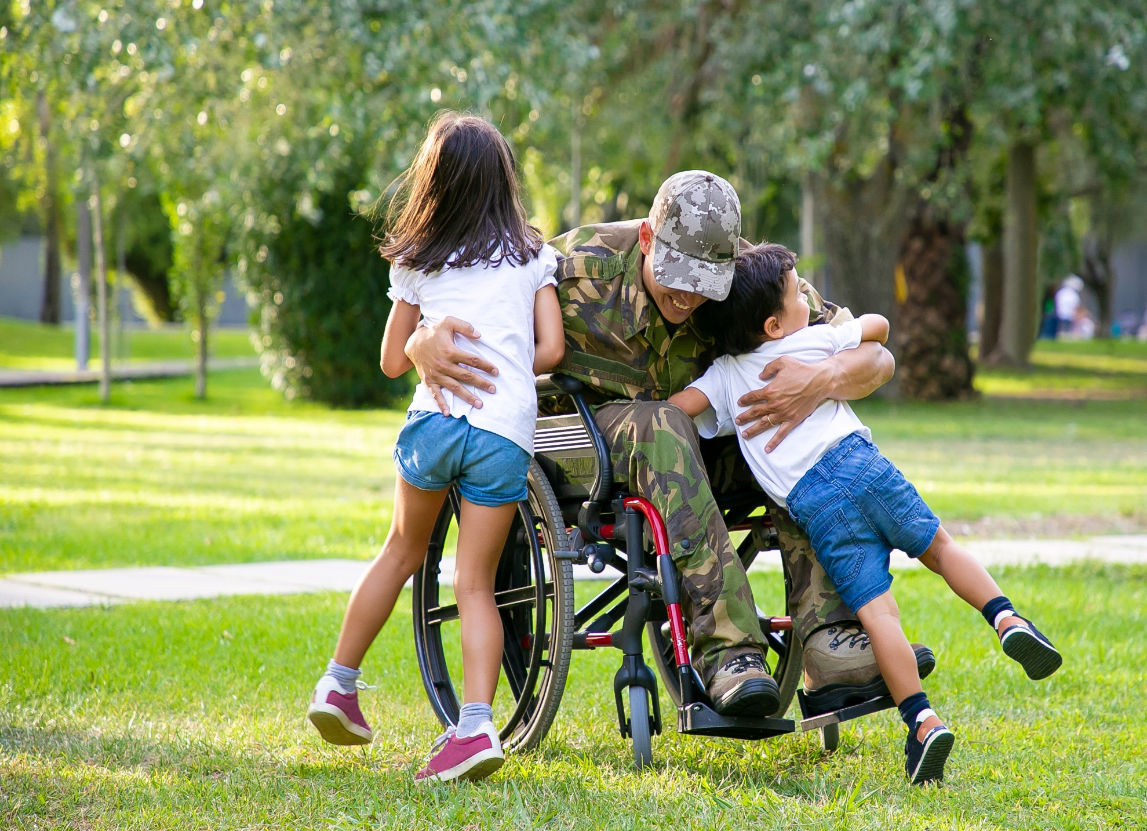
disabled veteran

Slide 17
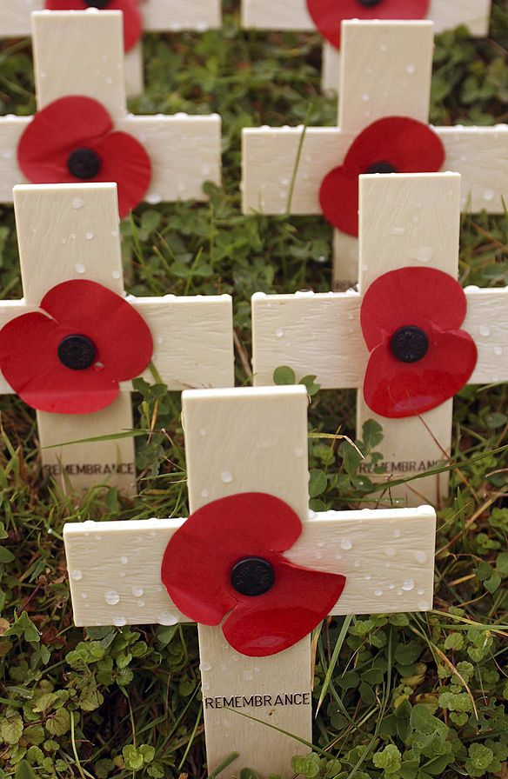
poppy cross

Slide 18
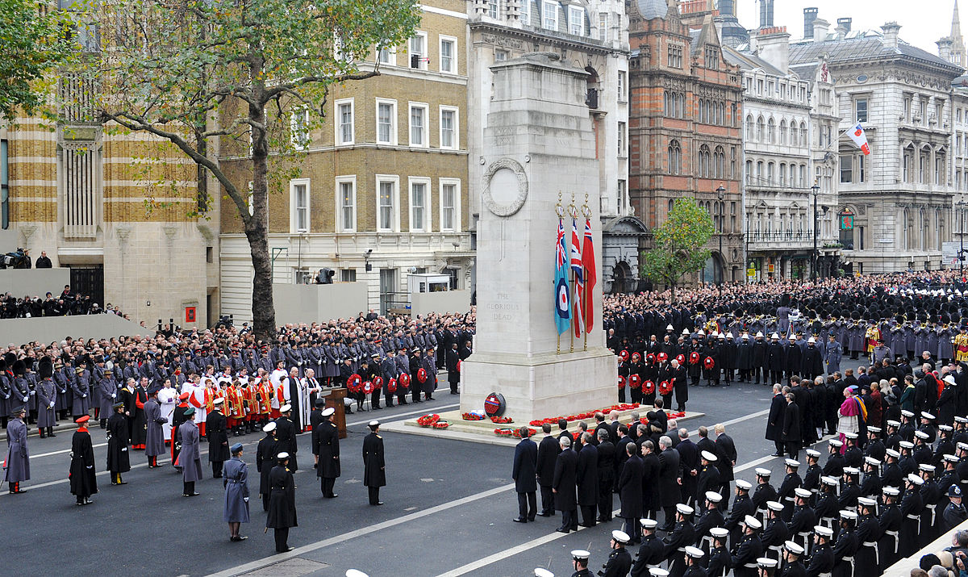
Remembrance Day

