Slide 1

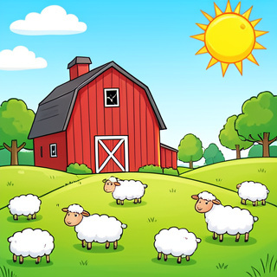
Our Trip to Manor Farm
Tuesday 11th March

Slide 2

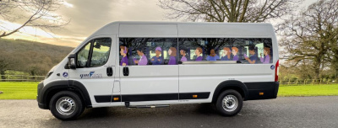
Getting There
The Mini Bus
We are going to Manor Farm on Tuesday 11th March.
We will leave school at 9:00am.
We will all travel together on a mini bus.

Slide 3
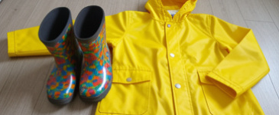

What Do I Need?
1
2
Clothes
Wear your school uniform. Bring your raincoat and wellies.
Food
Bring your lunch box and a water bottle.

Slide 4
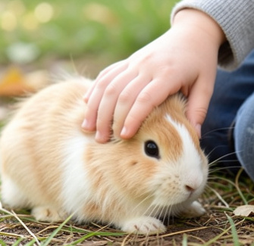
Meeting the Animals
Seeing the Animals
We will see lots of different animals at the farm.
Being Gentle
We might even hold some animals!
We must be quiet and gentle so they don't get scared.

Slide 5
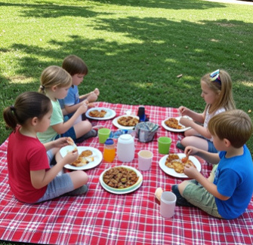
Lunchtime
Time to Eat
We will stop to eat our packed lunch at the farm.
Make sure you eat all your yummy food to give you energy for the afternoon!

Slide 6
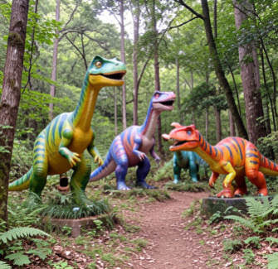
Dinosaurs and Play
The Dinosaur Trail
After lunch, we will explore the Dinosaur Trail and see the outdoor animals.
Soft Play
Then we will have fun in the soft play zone!

Slide 7
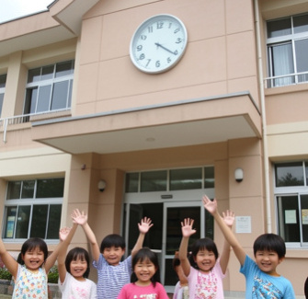
Back to School
Time to Go Home
Finally, we will get back on the mini bus.
We will arrive back at school at 3:30pm.
Your grown ups will be waiting to collect you.

