Slide 1
Welcome to Year 5!

Slide 2
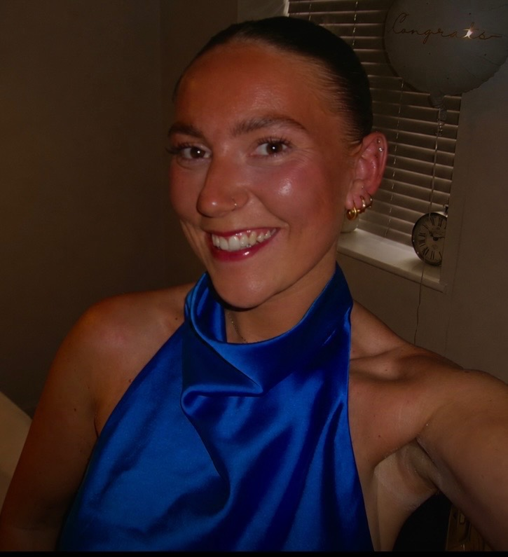
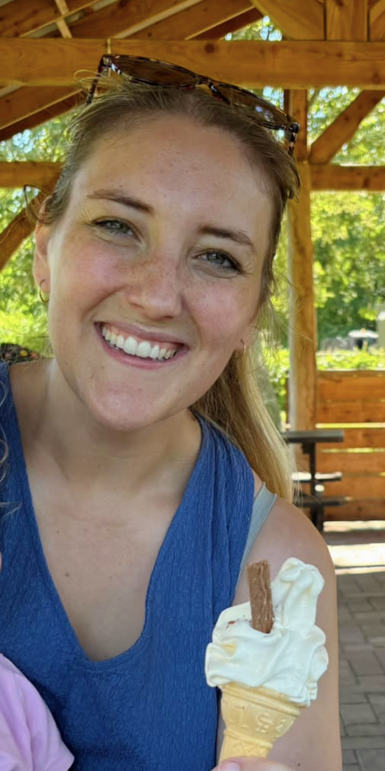
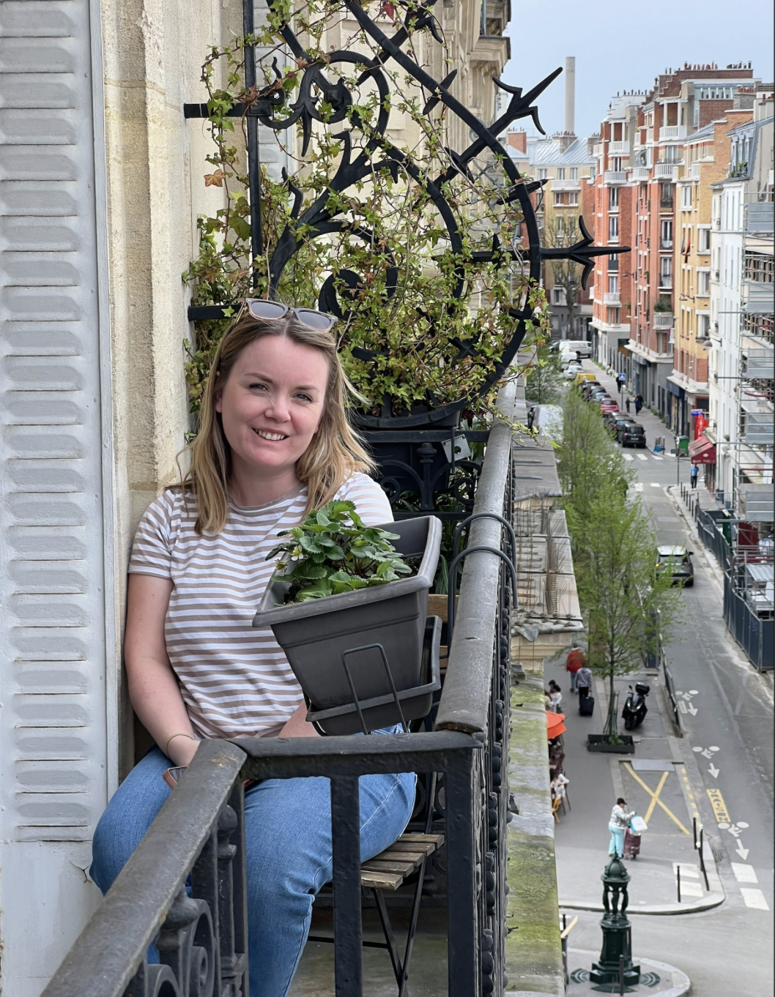
Staff that will be in year 5 this year are:
Miss Foster
Class teacher
Monday, Wednesday – Friday
Mrs Trussell
Teacher on Tuesdays
Mrs Braithewaite
Teaching Assistant Monday-Friday AM

Slide 3
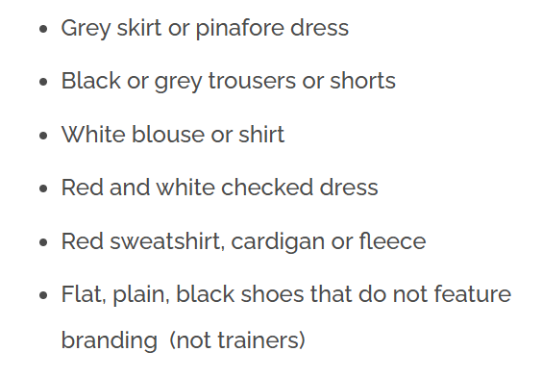
School uniform
Remember to label clothing
Appropriate clothing for the time of year e.g. winter coat during colder weather; hat and suncream during warmer weather
No jewellery to be worn apart from a pair of stud earrings which must be removed for PE

Slide 4
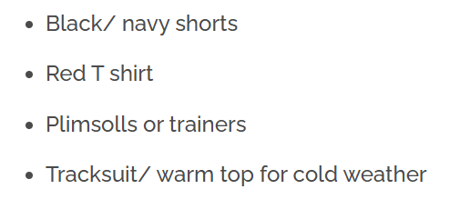
PE clothing
Remember to label clothing
Separate pair of shoes for PE
Long hair must be tied back for PE lessons

Slide 5
School equipment
Children can bring their own water bottle which should be kept in the designated space in the classroom (usually by the sink)
Children should not bring their own stationery
Children should not bring fidgets (if they have had a sensory assessment that says they need a fidget, this will be provided by school)

Slide 6

Homework expectations
Stay in the green zone on Doodle maths and spell
Read at least 3 x per week and record in the home/schoolbook
Home/schoolbooks should be brought into school every day
Complete the reading awards every term (Bronze for autumn, Silver for spring and Gold for summer) – these are all in the home/schoolbooks

Slide 7
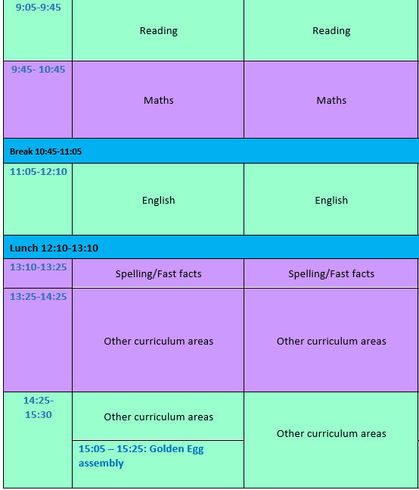
Example timetable
Mornings are very structured and focus on reading, maths and English
Afternoons cover all other curriculum areas and will change based on the half term

Slide 8
Arrangements for start and end of the day
Start of the day:
Children are to arrive from 8.50am (unless they come to reading lair, which starts at 8.30am)
Enter school through the door at the bottom of the UKS2 stairs and go straight to the classroom
Lunch boxes go on the trolley at the bottom of the stairs
End of the day:
Children leave through the door at the bottom of the UKS2 stairs

Slide 9
Mobile phones
School policy is that children don’t bring mobile phones to school, however, we appreciate that there may be exceptional circumstances where you need your child to bring their phone. In this situation, the phone should be handed in to Mrs Buttery in the office and collected again at the end of the day.
School can accept no responsibility for the damage or loss of phones on school site.

Slide 10
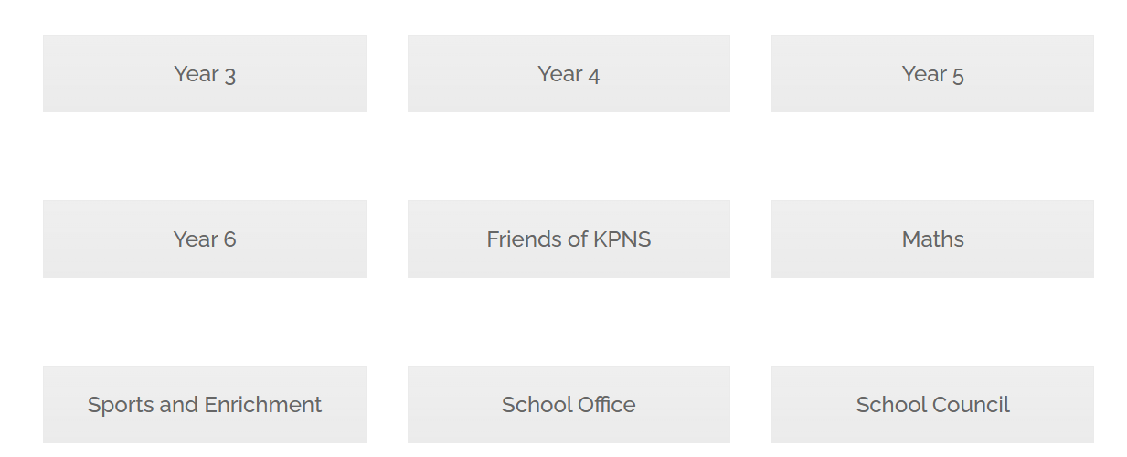
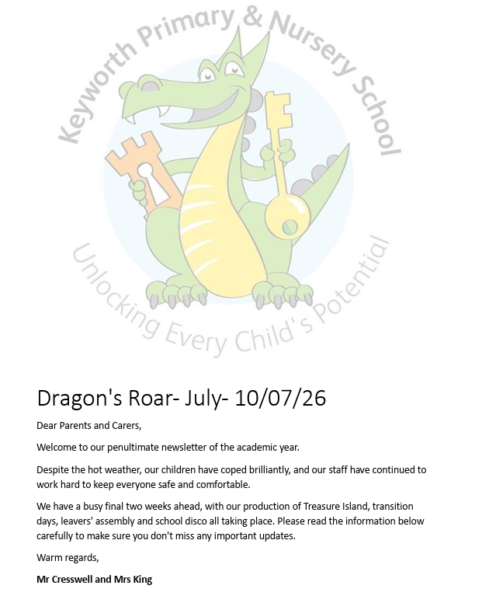
How we communicate
Fortnightly newsletter (Dragon’s Roar)
Class and subject blogs on the school website
Messages/emails sent through Arbor – all communication from parents is also to be sent through Arbor/via the school office.

Slide 11
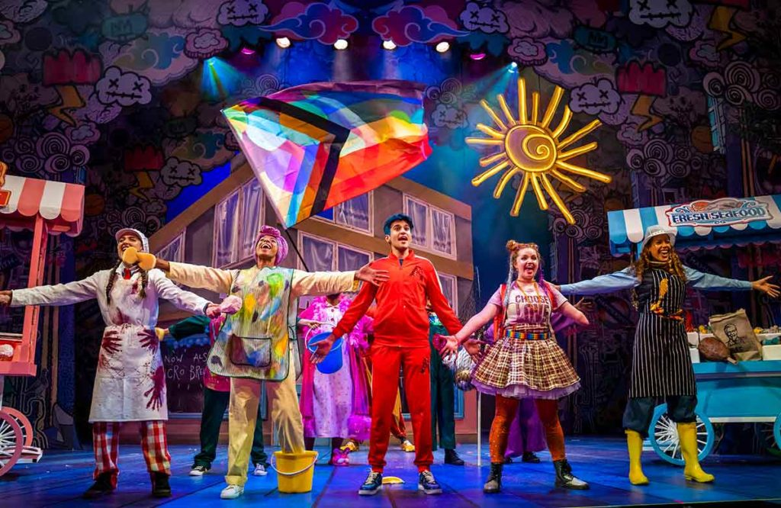
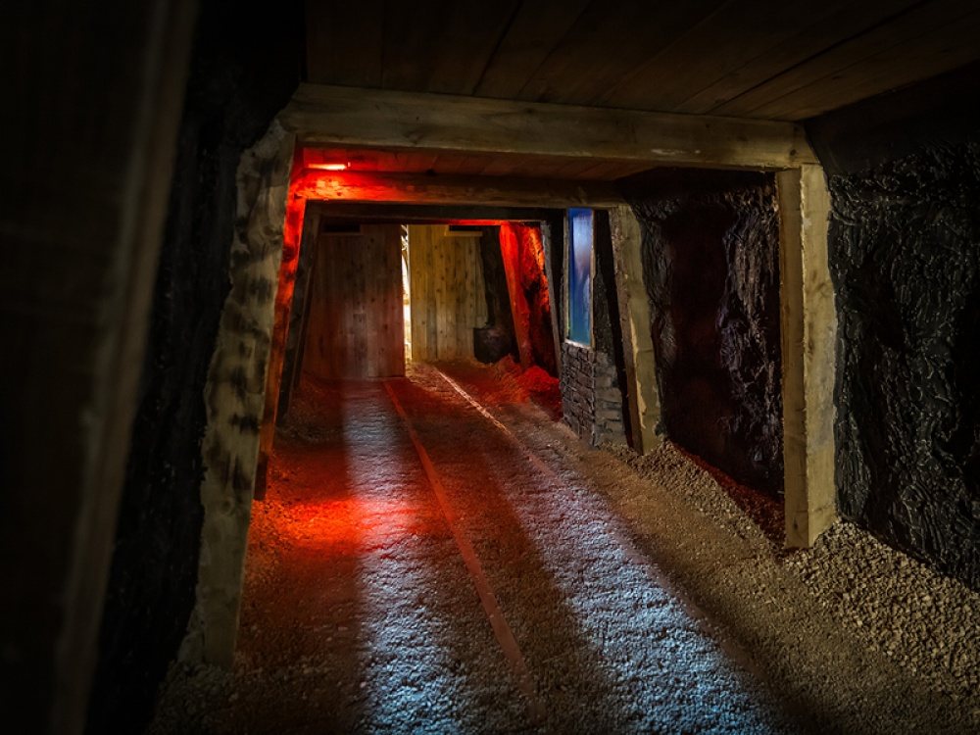
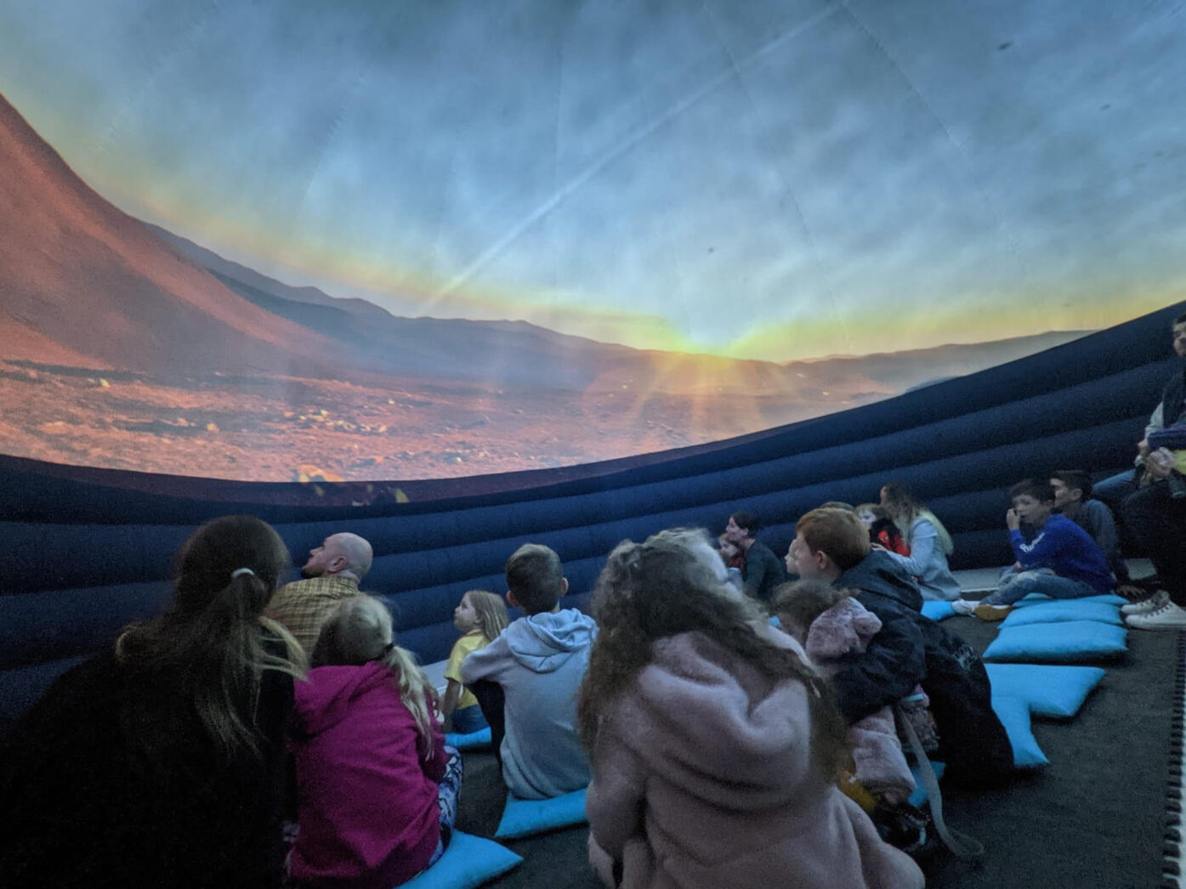
Trips/experiences
There are several things planned throughout the academic year
Pantomime
Coal mining museum
Planatarium

