Slide 1
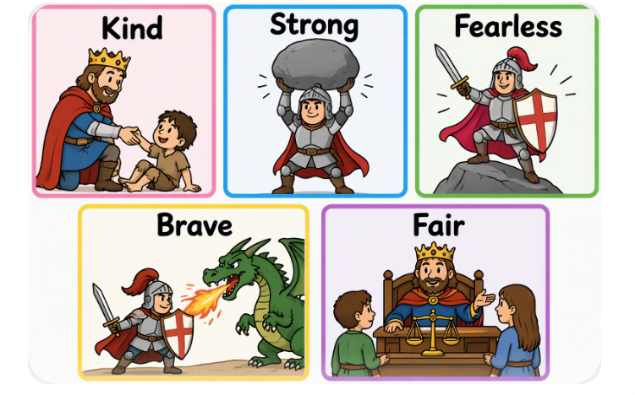
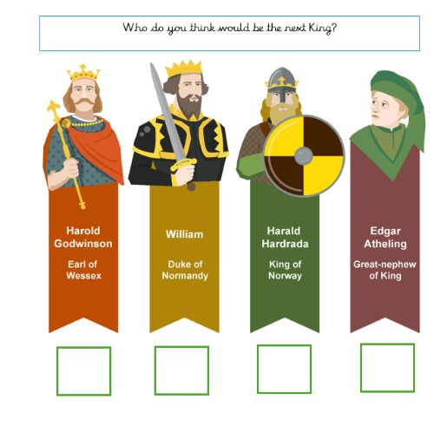
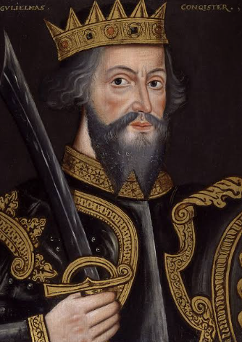
Big Idea: What happened in 1066?
5th January 1066 Edward the Confessor dies with no heir to the throne | 6th January 1066 Harold Godwinson becomes King of England | 28th September 1066 William of Normandy lands in England with his army. | 14th October 2026 Battle of Hastings. Harold is defeated and William of Normandy becomes King of England.
Key vocabulary | Definition
Heir | A person who will become King or Queen.
Rule | Someone in charge of a Country.
Throne | A special chair a King or Queen sits on.
Monarch | A King or Queen who rules a Country.
Normans | The French army led by William of Normandy.
Saxons | The English army led by Harold Godwinson.
Battle of Hastings | A battle fought to become the next King of England.
Bayeux tapestry | A large piece of fabric with handsewn pictures of the Battle of Hastings.
When was 1066?
1066 was almost 1,000 years ago.. It was important time because it decided who would rule England.
What is a monarch? What makes a good monarch?
A monarch is a King or Queen that rules the country. To be a good monarch you need to be:
Who will be the next King? Who was William the Conqueror?
Four different men wanted to be King this included: ​ | William was a cousin of Edward and from a Royal family but lived in France.​ He was a very good ruler in Normandy and thought he could do the same for England.

Slide 2
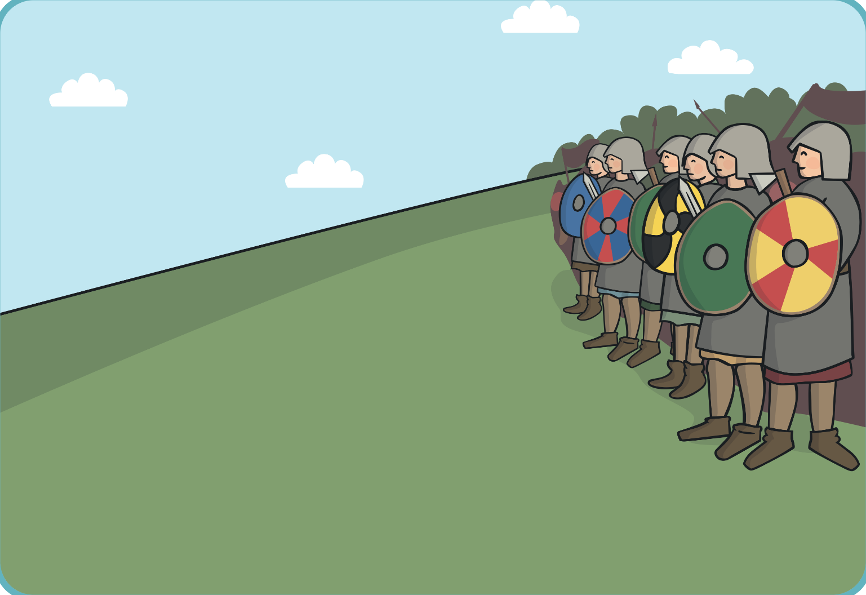
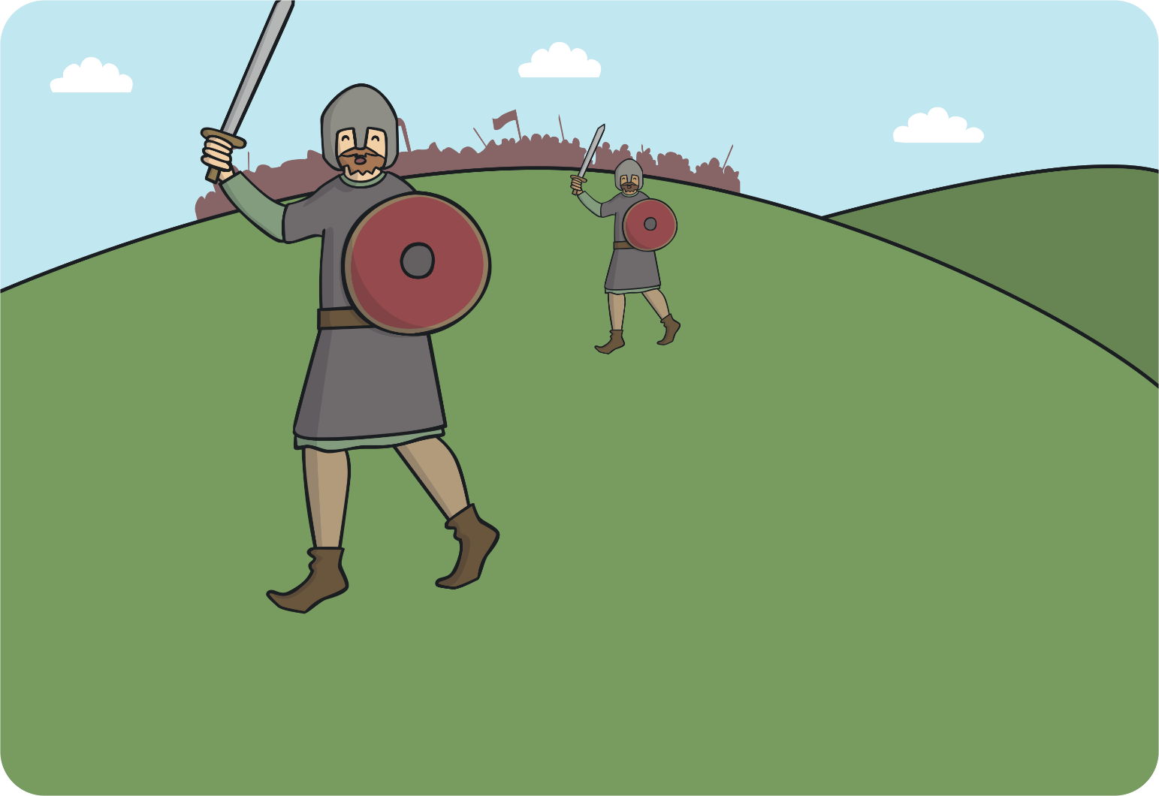
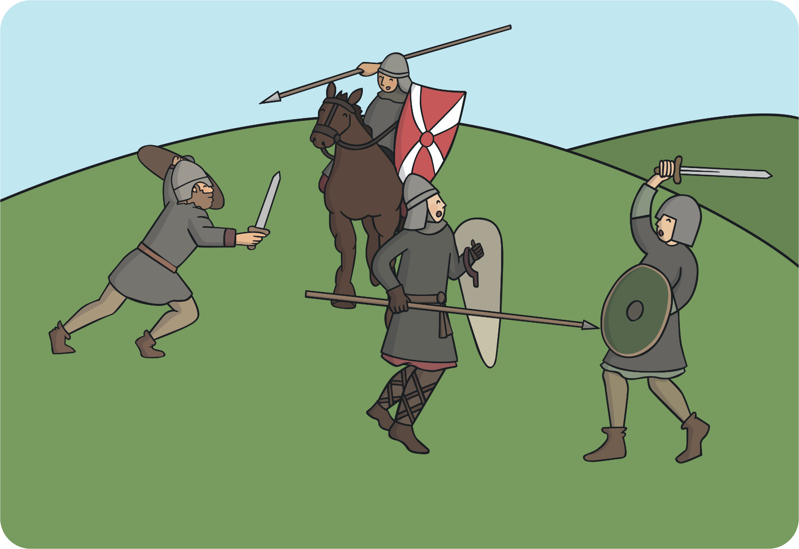
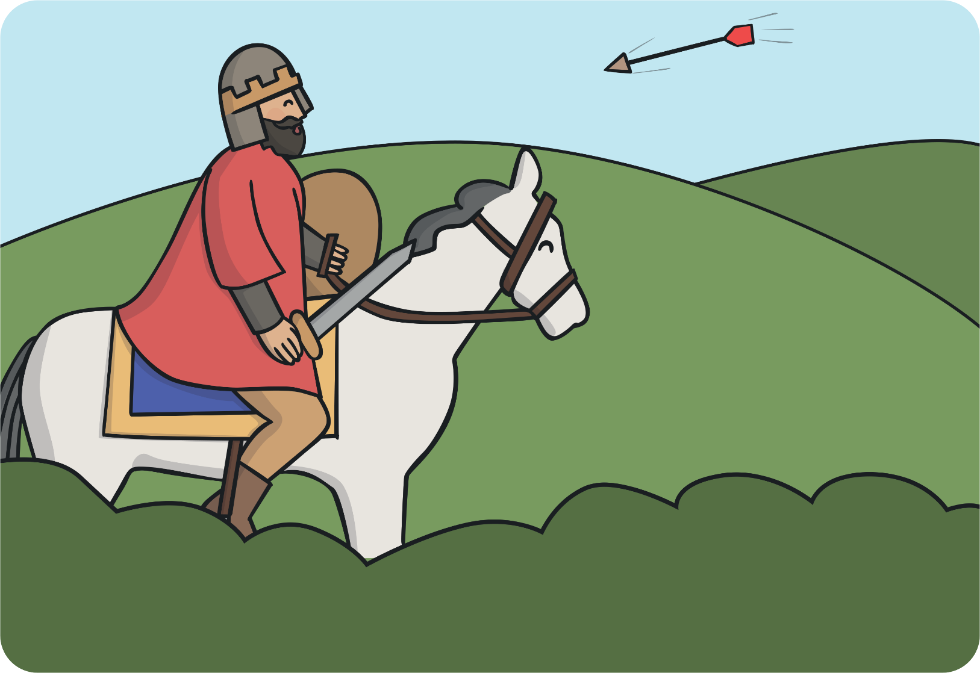
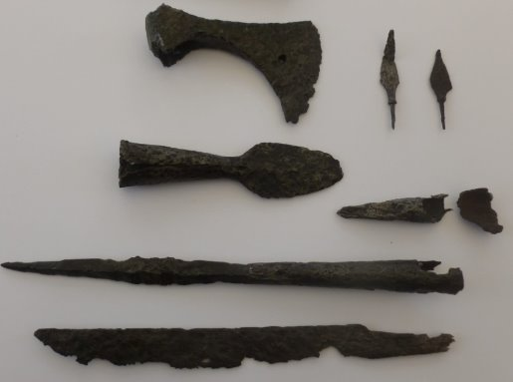
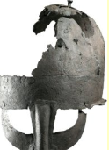
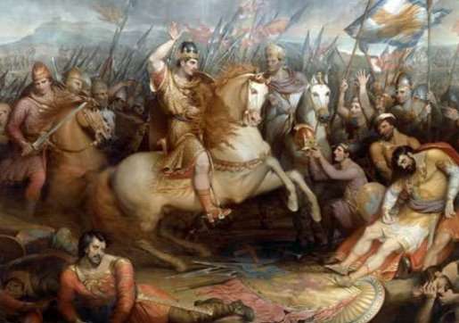
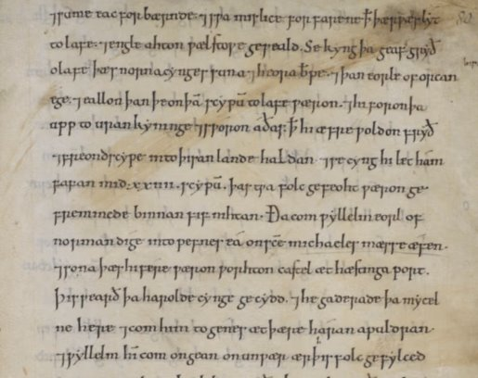
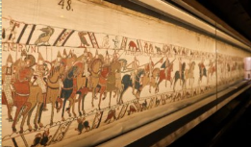
What happened in 1066?
Harold Godwinson took his army the Saxons into battle against William and the Normans. | Harold and his army made a mistake and broke their shield wall. This led to many of the Saxons being hurt by the Normans. | The Normas continued to attack the Saxons. | Harold was hit by an arrow in the eye and died. William became King.
How do we know about the Battle of Hastings?
We know about the Battle of Hastings because historians use historical clues from the past.
Bayeux Tapestry | Armour and weapons discovered. | Artwork | Written records

